Slide 1
Process Choreographies
Presenter: Ayça Avcı

Slide 2
Content
Motivation & Terminology
Development Phases
Process Choreography Design
High-Level Design
Collaboration scenarios
Compatibility
Process Choreography Implementation
Consistency criterion: Public-to-Private Approach
Service Interaction Patterns
Let’s Dance
Notes:
After motivating the need for process interactions and process choreographies as means to specify these interactions,
Development phases during choreography design are introduced.
The design and implementation of process choreographies is presented, introducing consistency notions that guide the correct implementation of process choreographies.
After introducing service interaction patterns, I will introduce Let’s Dance as concrete notations for specifying choreographies.

Slide 3
Motivation & Terminology
Business-to-business collaborations are quite complex.
The cooperation between companies should be designed very carefully.
Process choreographies can be used for this purpose.
The requirements of process choreography development depend on:
The number of interacting partners.
The desired level of automation.
Notes:
Any failure in the collaboration might have an immediate effect on the operational business of the company.

Slide 4
Bidding Scenario
Consider a bidding scenario:
The owner of a car uses an auctioning service to sell his car to the highest bidder.
Potentially, thousands of people can participate in the auction and place their bids.
Such scenarios require agreement on how the participants need to interact with each other to avoid problems that could appear as the result of wrong interaction.
Notes:
To avoid these kinds of problems, the partners involved in a process choreography need to agree on the process choreography.

Slide 5
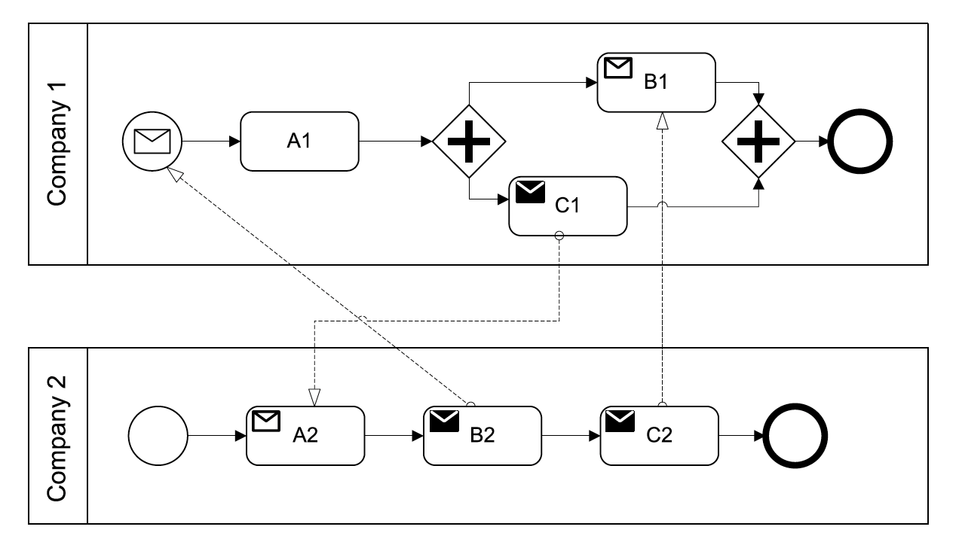
Deadlock Situation [1]
Process of Company 1 waits for B2 from Company 2 to be initiated.
B2 can be only performed when A2 is completed.
However, A2 waits for C1 from Company 1.
As a result, both process orchestrations cannot proceed.
DEADLOCK!
Notes:
Each of the process orchestrations shown in this figure exposes a valid behaviour if considered on its own. The behaviours are valid because each process instance will perform a set of activity instances before it completes.
The problem encountered is due to links between send and receive activities in the process orchestrations.

Slide 6
Development Phases
Goal:
To provide an understanding of the concepts and artefacts involved in the design of process choreographies.

Slide 7
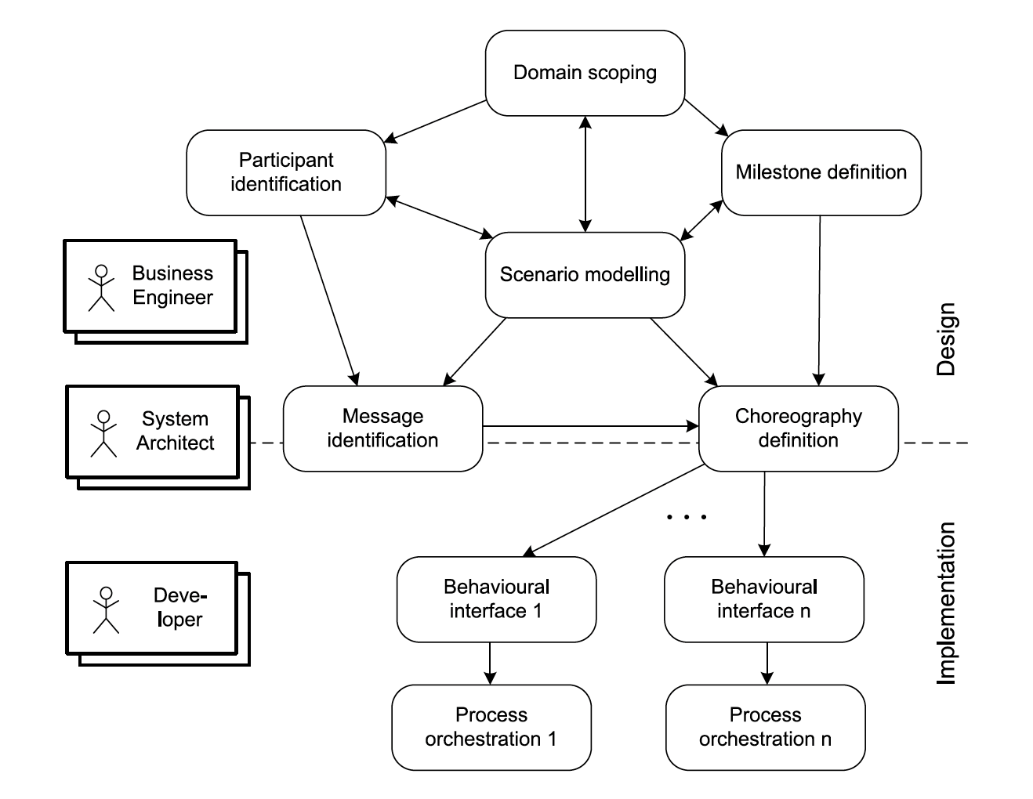
Phases during choreography design & implementation [1]
Business Engineer: Involved in choreography design phases, scenario modelling, domain scoping, milestone definition, and participant
identification (business related aspects).
System Architects: Responsible for the architectural aspects of the implemented process choreography. In particular, involved in specification of the behavioural interfaces.
Developer: Responsible for realizing the process orchestrations.
Notes:
These phases are organized into design phases and implementation phases, shown in the upper and lower part of that figure, respectively.
There are three associated roles that represent the stakeholders involved in choreography design and implementation.
They (business engineers) need to make sure that the collaboration contributes to the goals of the enterprise, similarly to organizational business processes.

Slide 8
Phases during choreography design & implementation [1]
Scenario modelling: Describes the overall setting and goals of the process choreography.
Domain scoping: A domain in which the cooperation will take place needs to be specified.
Participant identification: Defining different roles of choreography participants (refers to organizations, not individuals).
Milestone definition: Certain states of the choreography in which the cooperation has achieved certain results.
Notes:
Formal notations are not required in scenario modelling and domain scoping, so that the scenario and the domain can be described in a language that allows expressing the relevant concepts.
Milestones and their ordering describe behavioural aspects of the choreography from a high level of abstraction. They are usually a intermediate products.

Slide 9
Phases during choreography design & implementation [1]
Message identification: Design messages that realize the various interactions.
Choreography definition: Detailed specification of the interactions between the participants, the messages to realize the interactions, and the milestones that are reached during the resulting conversation.
Notes:
The design aspects include the business content of the messages, while the implementation aspects include the technical realization of these messages and concrete message formats.
Unsuccessful interaction behaviour would arise if, for instance, message formats were used that one or more participants would not understand. To avoid this problem, it is assumed that message formats as well as the semantics of the messages are agreed upon by the participants.
In the lower part of this figure, the phases during implementation of process choreographies are shown. Based on the choreography definition, behavioural interfaces of all roles in the process choreography are defined.
Behavioural interfaces serve as blueprints for the design of the individual process orchestrations realized by the participants of the process choreography.

Slide 10
Process Choreography Design
High-level Structure Design: The participant roles and their communication structures are identified.
High-level Behavioural Design: Specify the milestones of the collaboration and the order in which the milestones are reached.
Collaboration Scenarios: High-level choreographies are introduced with dedicated collaboration scenarios that relate the reaching of milestones to the communication between process participants.
Behavioural Interfaces: From the collaboration scenarios, for each participant role, a behavioural interface is derived.
Notes:
The design of process choreographies involves a series of activities. In each of these activities, artefacts are developed. These activities are described as follows.
High-level structure design is conducted during the participant identification phase.
High-level behavioural design is done during the milestone definition phase.
Collaboration scenarios are developed during the choreography definition phase, based on the scenarios informally specified during scenario modelling.

Slide 11
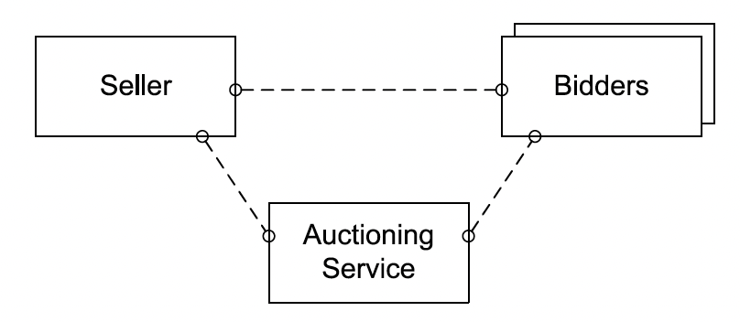
High-Level Structure Design [1]
Notes:
In high-level structure design, participant roles of the choreography are defined, as part of the participant identification phase. This figure shows high-level structure diagram for participants involved in a bidding scenario. This diagram identifies a seller, an auctioning service, and multiple bidders as participants. It also shows that these participants are pairwise interconnected. Therefore, any participant can interact directly with any other.

Slide 12
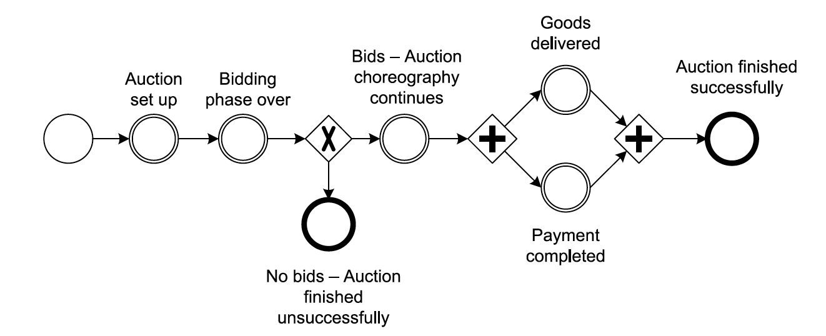
High-Level Behavioral Design [1]
Notes:
High-level behaviour design uses milestones that are achieved during the collaboration; it is therefore part of the milestone definition phase. Each milestone represents a state in the overall collaboration that has a business meaning, represented by some business value. Milestones correspond to subgoals reached during the collaboration on the way to reaching its ultimate goal.
For instance, the ultimate goal in the bidding scenario is that the offered goods are sold, paid for, and delivered to the bidder with the highest bid. Several intermediate steps can be distinguished: the initial setup of the auction, the entry of potential bidders into the auction, the actual bidding process, and the delivery and payment. Each milestone can be identified by an expression that describes the state
reached in that milestone.
In this figure, milestones are defined by circles, where the initial milestone has a single border, the intermediate milestones have double borders, and the ultimate goal milestone has a bold border.

Slide 13
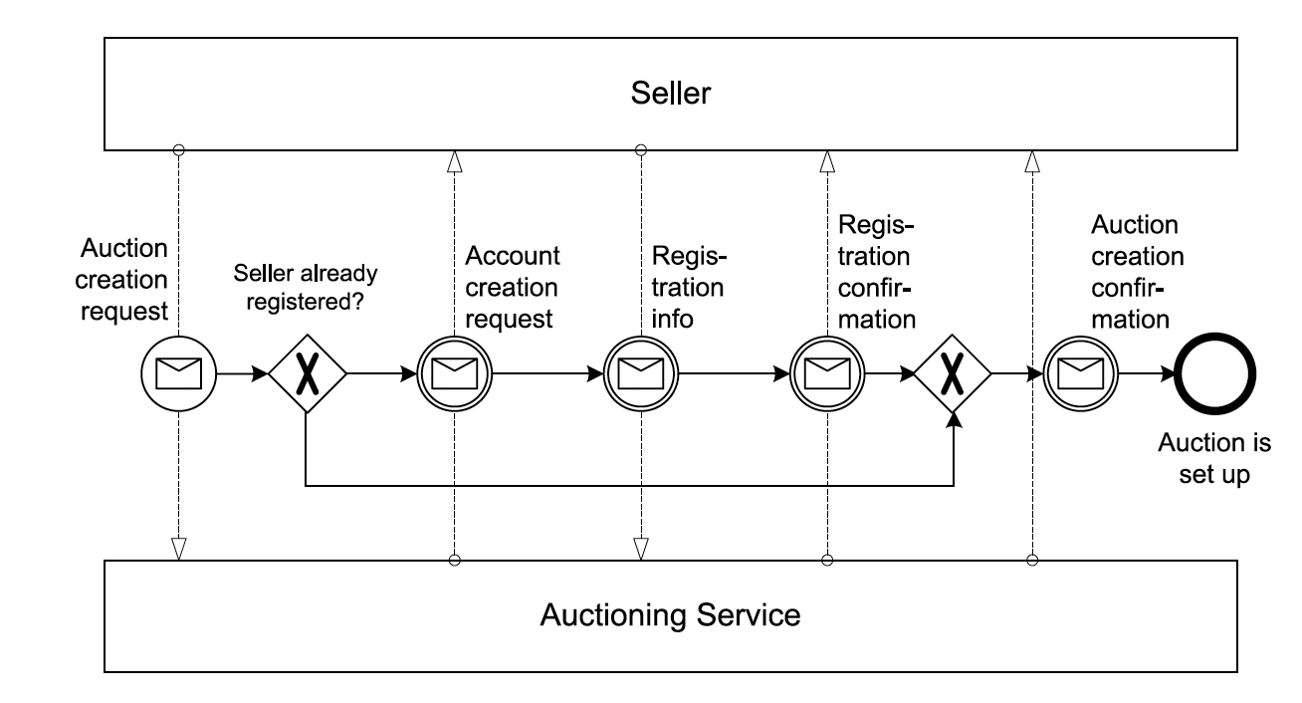
Collaboration Scenario [1]
Notes:
Having identified the collaboration milestones, collaboration scenarios can be addressed, as part of the choreography definition phase. In this phase, the interactions needed to proceed from one milestone to another are specified.
One or several collaboration scenarios show the interactions and their dependencies that need to occur between two milestones. To this end, interactions between process participants serve as the building blocks for the resulting collaboration scenarios.
Scenarios should be kept small, as it is easier to reach agreement on less complex interaction behaviour. Additional scenario models might be introduced to deal with special cases and exceptions.

Slide 14
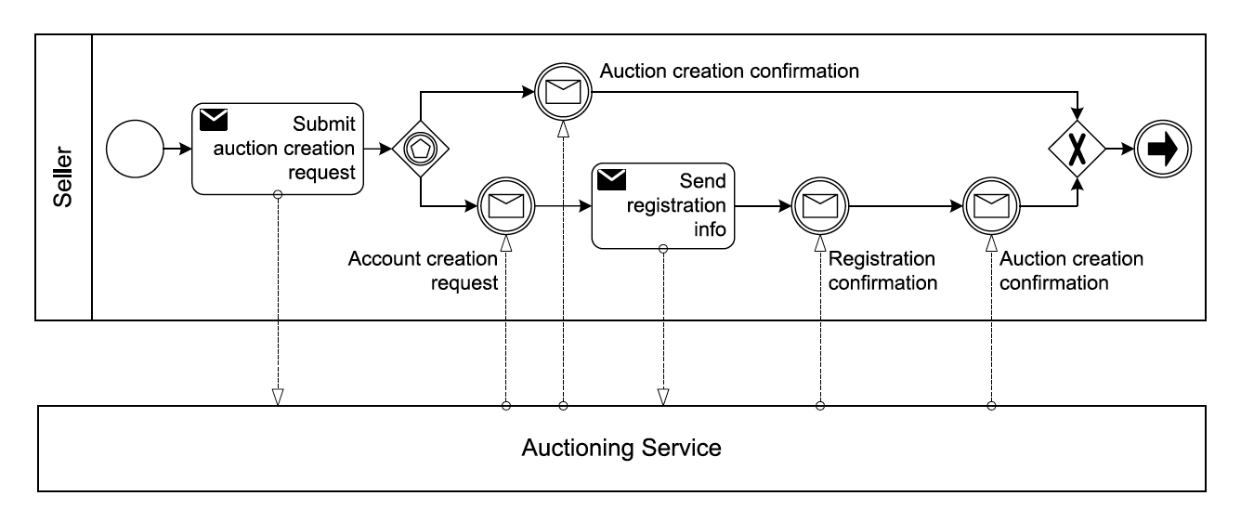
Behavioural Interface [1]
Notes:
A behavioural interface covers the individual view of one specific participant in the process choreography; the internal aspects of the own process orchestration, as well as the interactions involving only other participants, are disregarded.
Behavioural interfaces consider parts of process orchestrations that exhibit externally visible behaviour, for instance, communication activities and events that represent the sending or receiving of a message.

Slide 15
Compatibility
Process choreography design needs to ensure that the process orchestrations of the participants play together well in the overall collaboration.
Compatibility is the ability of a set of participants to interact successfully according to a given process choreography.
Structural compatibility
Strong structural compatibility
Weak structural compatibility
Behavioural compatibility
Notes:
Compatibility of interacting processes aims at avoiding this type of undesired behaviour due to erroneous interactions between process orchestrations.
Different message formats (content of the message is not clear), wrong/misaligned interactions (deadlock situations) are the reasons for incompatibility.

Slide 16
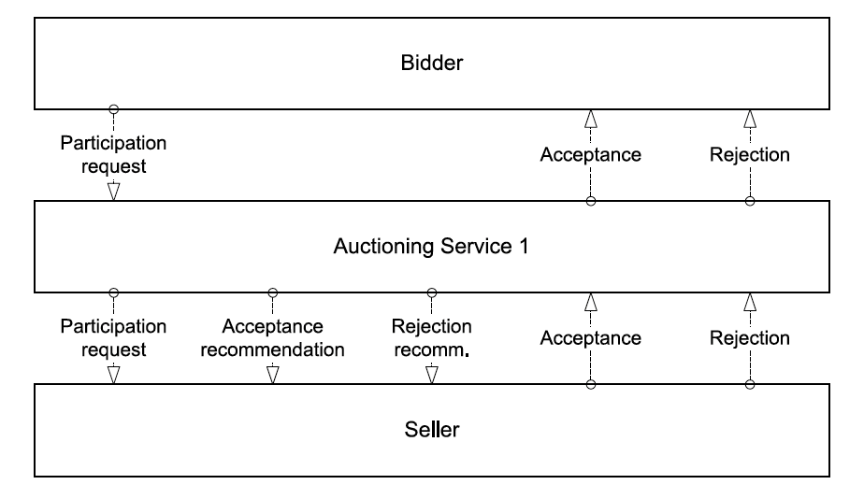
Structural compatibility [1]
Strong structural compatibility: For every message that can be sent there is a participant who can receive it, and if for every message that can be received, there is a participant who can send it.
Notes:
Explain the diagram (pretty straightforward).
Structural compatibility: Only the structure of the interaction is taken into account.

Slide 17
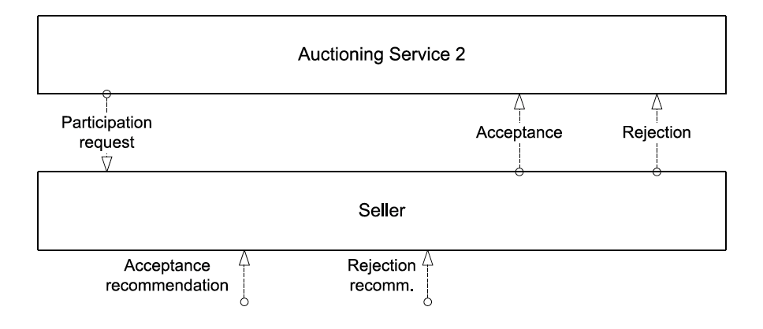
Structural compatibility [1]
Weak structural compatibility: If all messages sent by participants can be received by other participants.
Notes:
Since the individual process orchestrations have in most cases been developed independently of each other, a complete structural match between participants cannot always be achieved.
Thus, the occurrence of weak structural compatibility is more likely.
In this case, all messages sent can be received, but it is not required that for every message that can be received there be a participant who can actually send such a message.

Slide 18
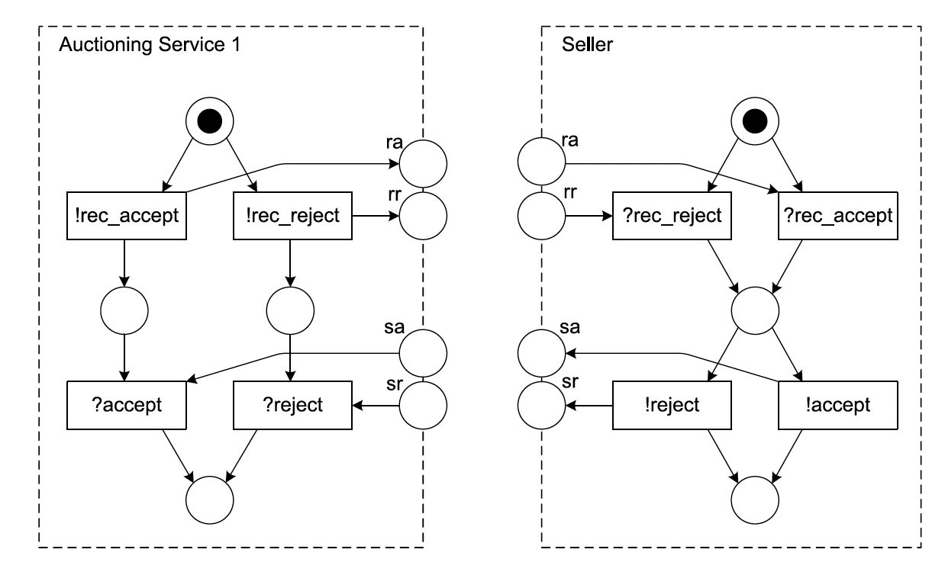
Behavioural compatibility [1]
Workflow modules are not workflow nets!
In workflow nets, each place and each transition is on a path from the initial node to the final node. Thus, only the initial place can have no incoming edge and only the final place can have no outgoing edge.
In workflow modules this is not true, because communication places by definition have either no incoming edges (places for receiving messages) or no outgoing edges (places for sending messages).
Notes:
Unlike structural compatibility, behavioural compatibility considers behavioural dependencies, that is, control flow between interaction instances of a conversation.
Therefore, the process orchestrations of the interacting partners are interconnected, and the resulting process structure is analyzed. Such analysis requires a formal, unambiguous representation.
In an approach for checking behavioural compatibility, process orchestrations are represented by a specific class of Petri nets, namely workflow modules. Workflow modules are basically workflow nets with additional communication places that are used to represent message flow between participants.
Whenever a participant sends a message, the process orchestration of that partner features a transition with an output communication place that can hold messages sent. At the receiver side, the workflow module requires a matching input communication place. This place is an input place of the transition that receives the message.
Each process orchestration is represented by a workflow module that defines its internal behaviour and its external communication behaviour.

Slide 19
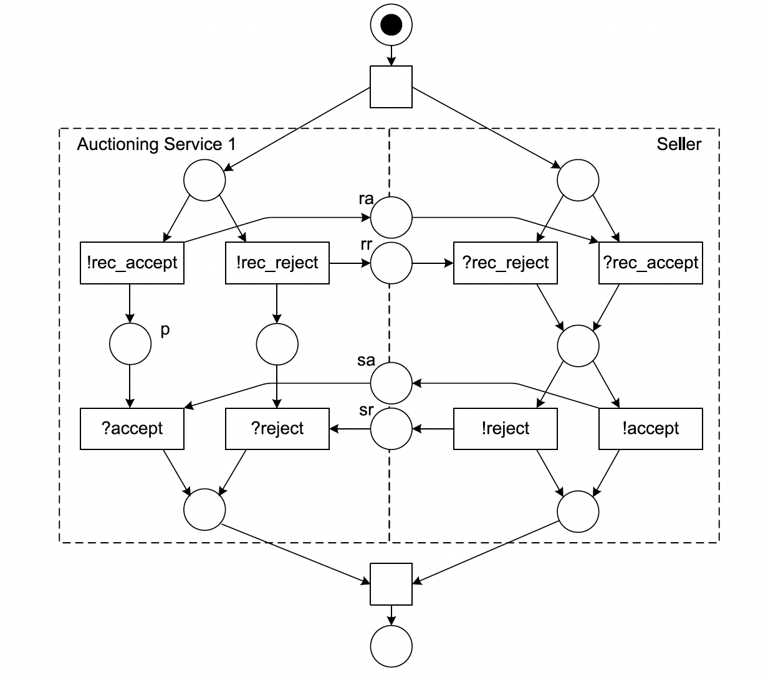
Behavioural compatibility [1]
This Petri net is a workflow net since there is one dedicated initial place and one final place, and each node is on a path from the initial place to the final place.
But, the composition of workflow modules is not satisfactory.
Consider a process instance in which the auctioning service recommends accepting the bidder, while the seller decides to reject the bidder.
Notes:
Communication places act just as normal places in Petri nets. A transition with a communication place as an input place is enabled only if there is a token in that place. Thereby, message flow can be represented properly. The receiving transition can only be performed if a message has arrived. The workflow module approach requires strong structural compatibility of the workflow modules. Therefore, there need to be corresponding places for all communication places in each module.
In this figure, the corresponding communication places are merged, and a new initial place and a new final place are added.

Slide 20
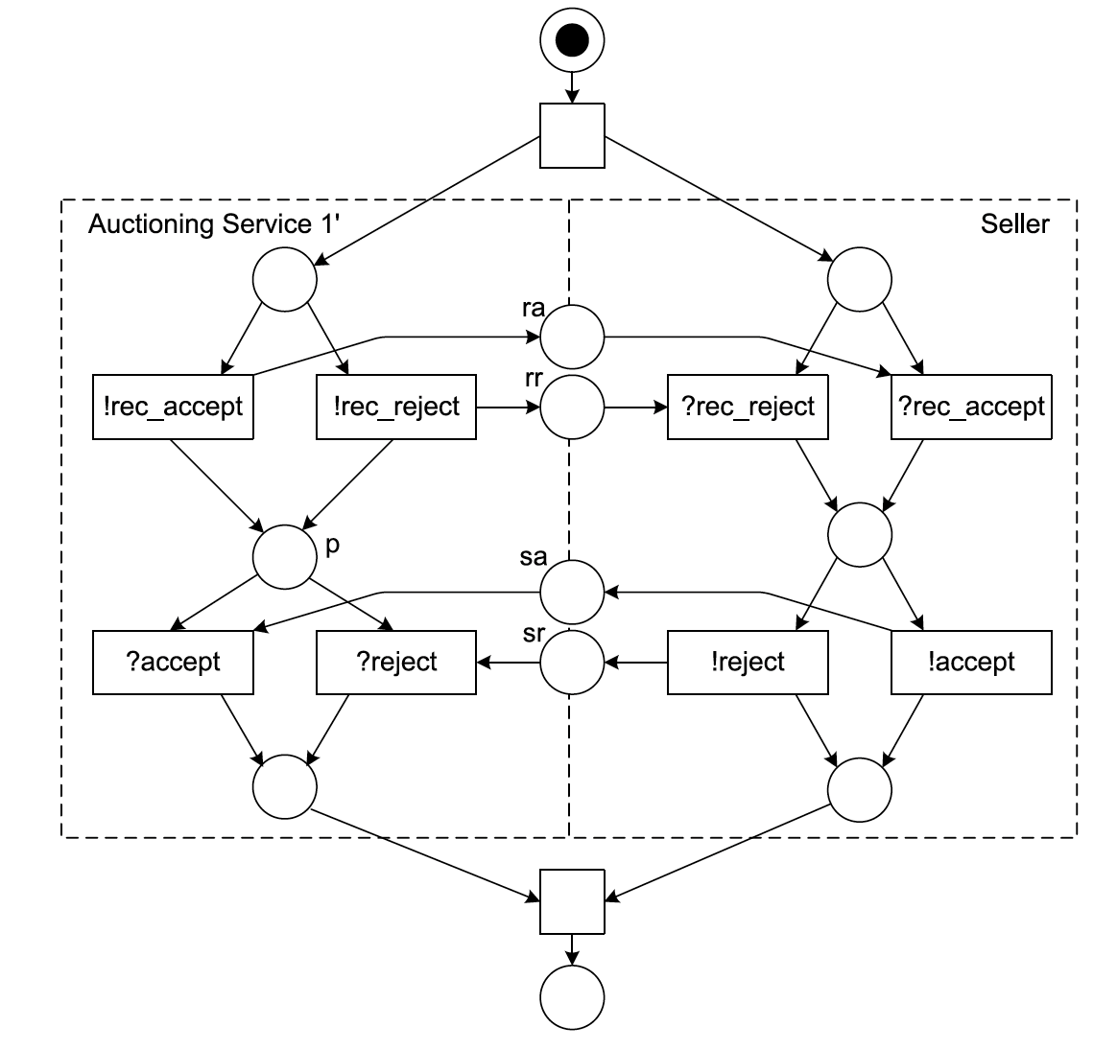
Behavioural compatibility [1]
Notes:
While this specification describes the interaction between the participants of a conversation, it also allows extending the internal processes of the individual participants.
The auctioning service could, for instance, look up historical data about the buyer before proposing a recommendation and sending it to the seller. The seller could also have an internal decision making process in place, possibly spanning different organizational units, to accept or reject a buyer request.
No matter how the internal processes of the participants look like, we need to make sure that these internal processes are in line with their behavioural interfaces.

Slide 21
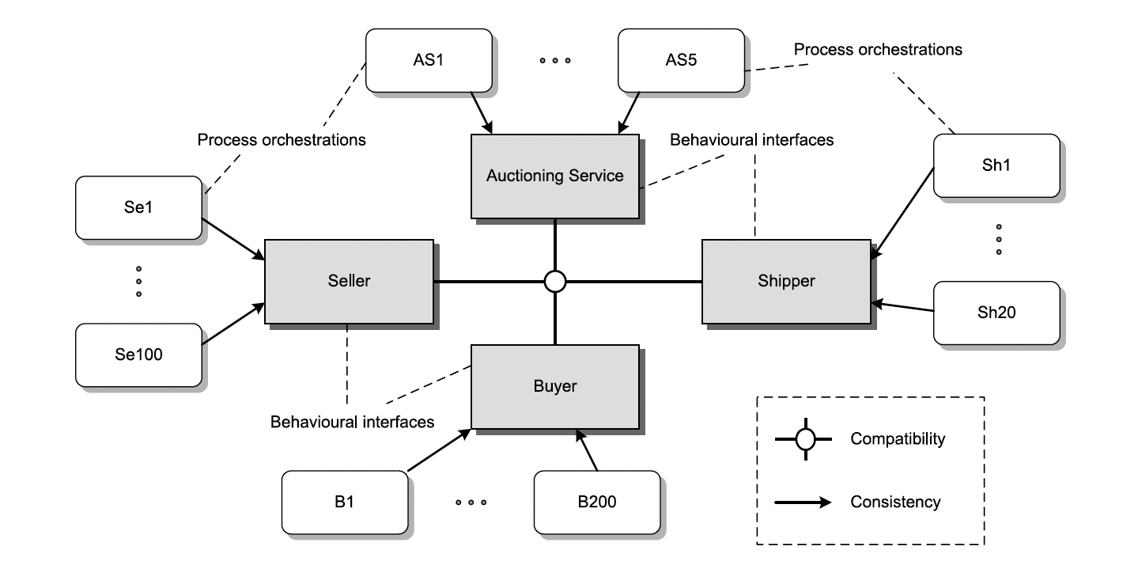
Process Choreography Implementation [1]
Each participant role is specified by a set of its behavioural interfaces.
They need to be compatible with each other, so that the collaboration can be successful.
Notes:
Assume that there is a set of behavioural interfaces compatible with each other. These interfaces can now be refined to local process orchestrations. In local process orchestrations, activities can be added or, in some cases, even reordered, while the observable behaviour has to be preserved.
The relationship between the behavioural interface and the local process orchestration needs to be investigated, so that the correctness of the overall collaboration can be achieved.
These process orchestrations need to be consistent with the behavioural interface of the participant role. For instance, the process orchestration of seller Se1 needs to be consistent with the behavioural interface of the Seller role. Using consistency rules, each participant can check locally whether its local business process orchestration fits its behavioural interface.

Slide 22
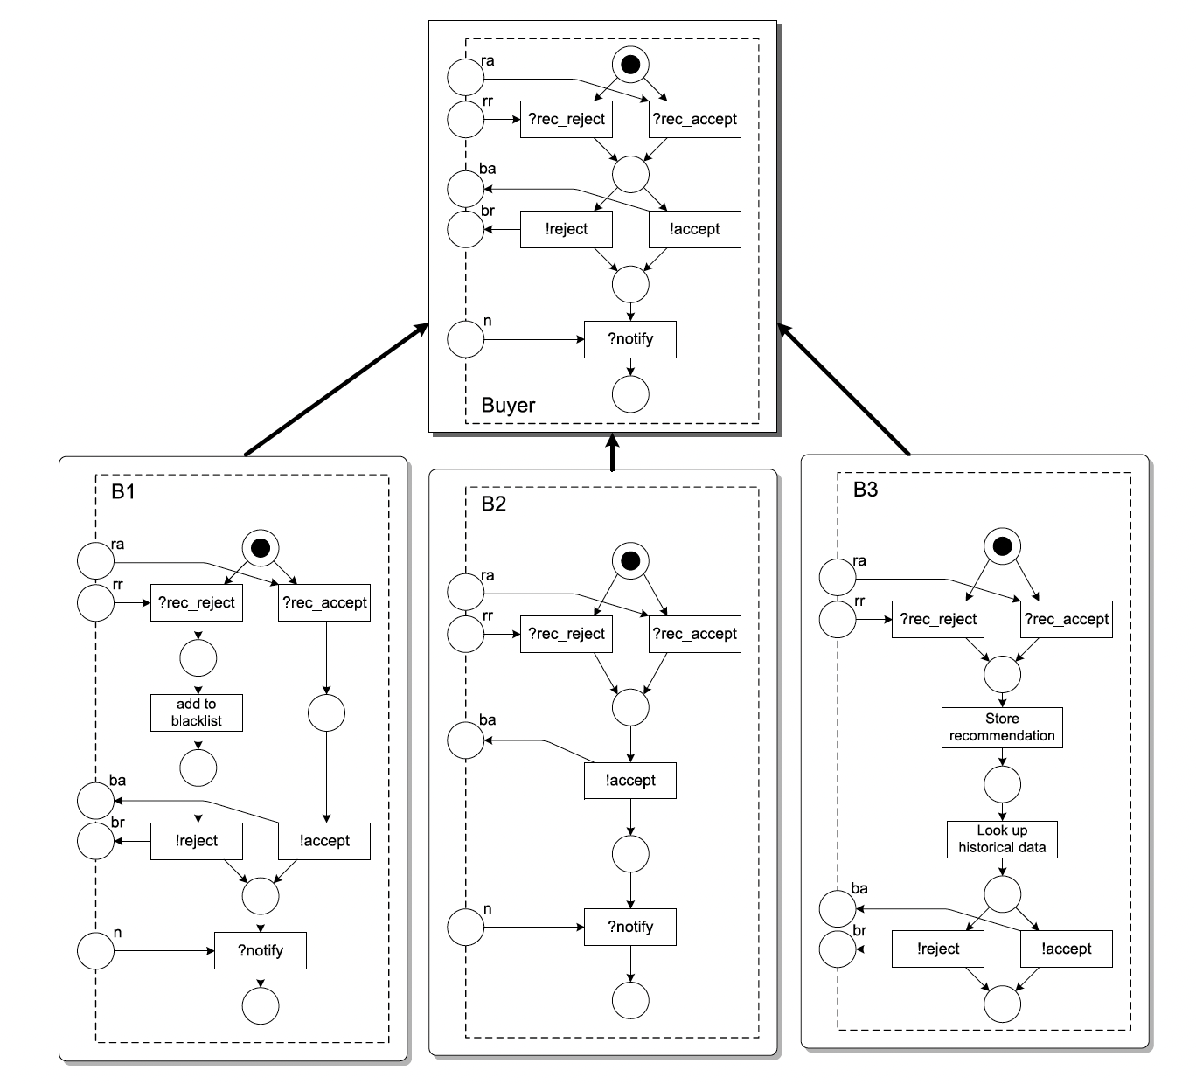
Notes:
The behavioural interface of a participant role leaves room for multiple process orchestrations, that is, there are multiple process orchestrations consistent with a given behavioural interface.
B1 has the same set of communication places as the behavioural interface of the Buyer role, but different control flow. B2 and B3 have different communication places than the behavioural interface. The question now is whether any of these implementations is consistent with the behavioural interface of the Buyer role.
We can argue that all three local process orchestrations are consistent with the behavioural interface of the buyer:
B1 stores negative recommendations in a blacklist, and it always follows the received recommendations sent by the auctioning service. This realizes a behaviour that is consistent with the interface, although not all possibilities of the buyer interface are realized: B1 does not decide about accepting a seller on its own but always follows the recommendation received.
B2 accepts every seller, so that the recommendations received are discarded. We can argue that the behaviour of B2 is consistent with the buyer interface, although not all behaviours are possible, that is, B2 cannot reject a seller.
B3 stores the recommendation received and makes an independent decision about accepting a seller. We can argue that this behaviour is also consistent with the buyer interface, because B3 can communicate as specified, at least regarding recommendation and decision messages. However, B3 is not able to receive a notification message. If we assume that this message is not essential then also B3 is a valid implementation of the buyer interface.
This discussion shows that the decision on whether an implementation is consistent with a behavioural interface is subject to consistency criteria.

Slide 23
Consistency Criterion: Public-to-Private Approach
Loop: By adding a loop with start place and end place of the loop being exactly one place in the public process, the process can be transformed.
Detour: An edge in the Petri net can be substituted by a subnet, which implements a detour of the original flow, defined in the public process.
Concur: A concurrent branch can be added by designing a subnet which is spawned concurrently to the original flow, later to be synchronized with the flow.
Notes:
Each local process orchestration needs to be consistent with the respective behavioural interface definition. This section will introduce consistency criteria using a business-to-business collaboration scenario.
The public-to-private approach defines a consistency criterion. It is based on Petri nets and uses notions of behavioural inheritance to characterize the relationship between a behavioural interface and a private process orchestration.
First, the partners agree on a choreography, which is defined as a Petri net. The net is partitioned among the partners, defining the responsibilities of the partners regarding the overall choreography.
The partition of each partner defines its behavioural interface, that is, the public process of the partner. This public process can be enhanced to implement a private process orchestration. The refinement of a public process to realize a private process can only be done by a set of transformation operations, which are graph operations on the Petri net.

Slide 24
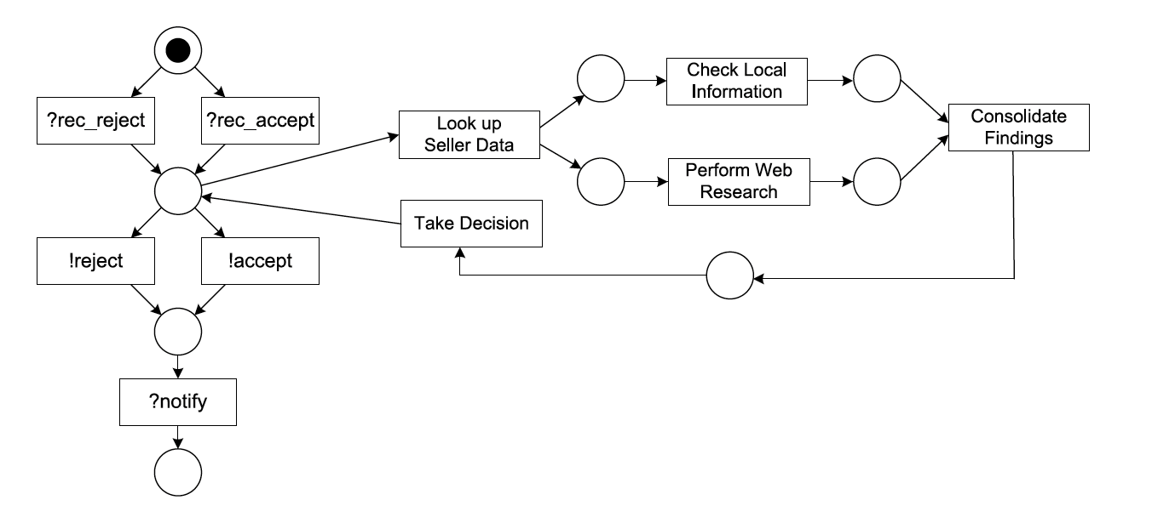
Loop transformation operation [1]
Notes:
Define it.
From this example, it is also clear that the behavioural interface of the process is not changed by that operation. All communication operations— those that receive or send messages—and their behavioural constraints are unchanged.

Slide 25
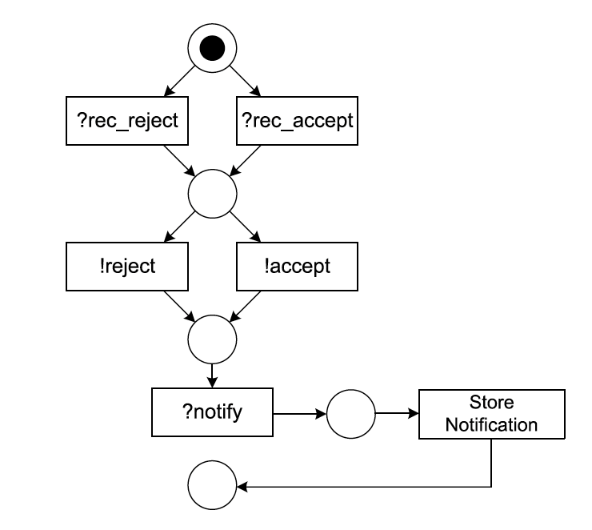
Detour transformation operation [1]
Notes:
Define it.
In the example shown, the detour consists of a single activity only, an activity for storing the received notification. In general, the detour may consist of a more complex net structure.
As for the other transformation operations, the added subnet needs to be sound meaning that there are neither deadlocks nor lack of synchronization.

Slide 26
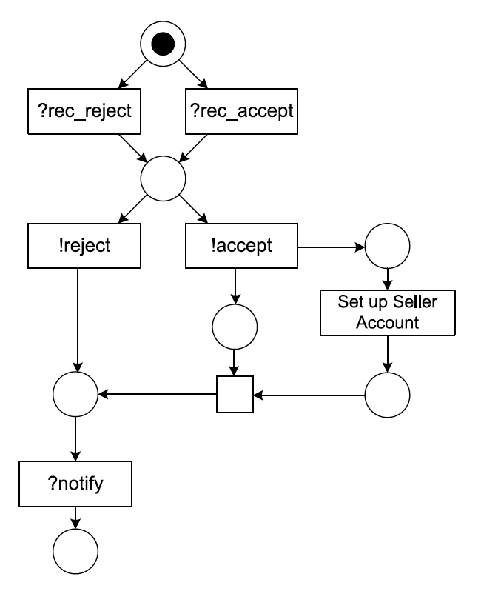
Concur transformation operation [1]
Notes:
Define it.
The buyer sets up a seller account after sending an acceptance message. In a more general setting, the added parts of the private process can be performed concurrently to other parts of the process, which is indicated by the parallel split behaviour of the !accept transition.

Slide 27
Is private process B1, B2 or B3 consistent with public process Buyer (B)?
B1: No. B1 cannot send an acceptance message after receiving a rejection recommendation, although this is a legal behaviour of B.
B2: No. B2 does not even have the same set of transitions that B has (B2 can never send a rejection message).
B3: No. B3 cannot receive a notification message as B does.
Notes:
Discuss whether the private processes of buyers B1, B2, or B3 are consistent with the public process of the buyer.
B1 cannot be derived from the public process of the buyer using the transformation operations only. This is not surprising, since B1 cannot behave like B can behave. In particular, B1 cannot send an acceptance message after receiving a rejection recommendation, although this is a legal behaviour of B. Therefore, B1 is not consistent with B.
B2 does not even have the same set of transitions that B has. B2 does not expose the complete behaviour of B, for example, B2 can never send a rejection message.
For the same reason, B3 is not consistent with the public process of the buyer. B3 cannot receive a notification message.
This discussion illustrates that the public-to-private approach is based on a strict notion of equivalence (namely branching bisimulation). On the other hand, it makes sure that the combination of the private processes still exposes correct behaviour.

Slide 28
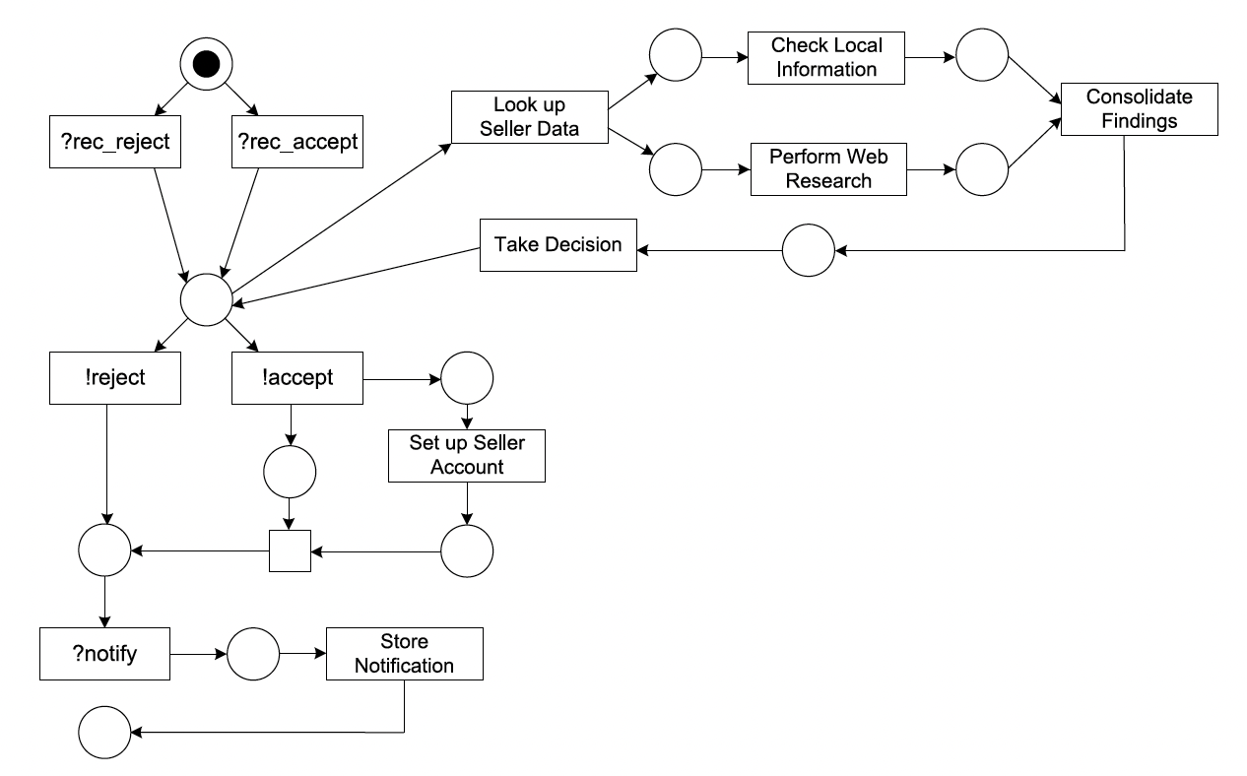
Combined transformation operations [1]
Notes:
On the other hand, there are quite complex extensions possible with this approach. To illustrate this claim, this figure shows the private process of a buyer, with the combined transformation operations applied.
This private process that—according to the public-to-private approach—is consistent with the public process of the buyer. Despite the relative complexity of that private process, we can argue that it exposes exactly the same behaviour as the public process of the buyer role (notice that branching bisimulation disregards silent activities).
The process starts by receiving a recommendation message. Then either a message is sent or a loop is iterated. If an acceptance message is sent, a seller account is set up. In any case, a notification is received, stored, and the process terminates properly.

Slide 29
Service Interaction Patterns
Proposes small granular types of interactions that can be combined to process choreographies.
Can also be used to benchmark languages for their ability to express advanced conversations as with control flow patterns for process orchestrations.
Includes following schemes:
Number of participants involved
Number of messages exchanged
Variations in message receiver
Notes:
Choreographies are based on message exchange, and potentially many participants interact in a choreography, while orchestrations are based on control flow between the activities of a single process performed by a single organization.
Bilateral interactions involve two participants, whereas multilateral interactions involve more than two participants.
Single transmission versus multi-transmission interactions.
In case of two-way interactions, round-trip interaction means that the receiver of the message is necessarily the same as the sender, whereas routed interaction means that the receiver of the message in general differs from the sender.

Slide 30
Service Interaction Patterns
Send
Receive
Send/Receive
One-to-many send
Request with referral
Notes:
Only some of them presented due to time constraints.

Slide 31
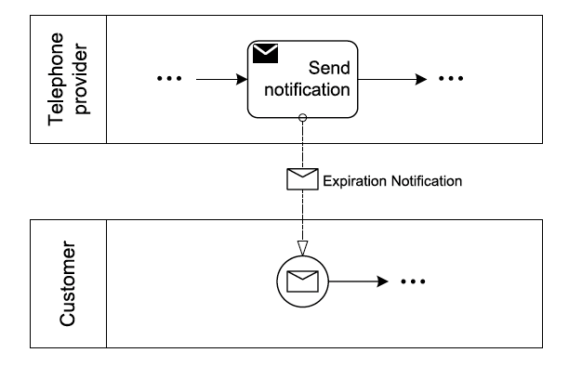
Send [1]

Slide 32
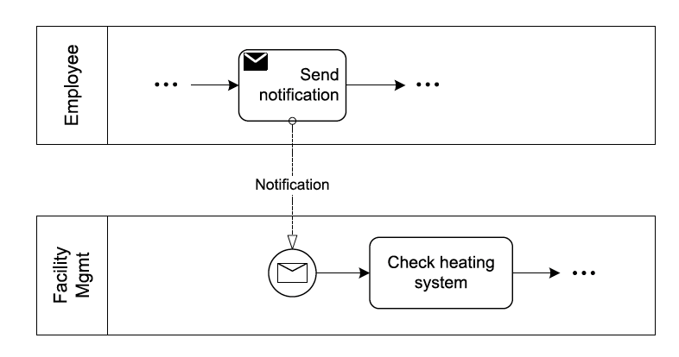
Receive [1]

Slide 33
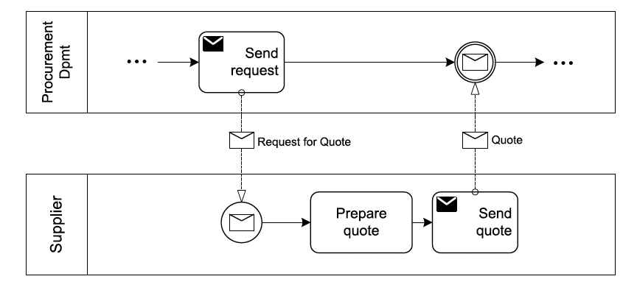
Send/Receive [1]

Slide 34
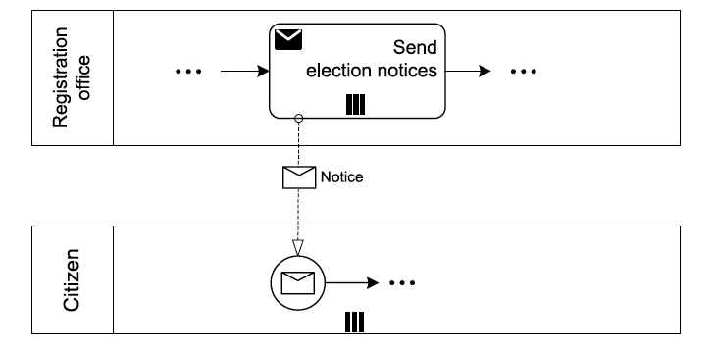
One-to-many send [1]

Slide 35
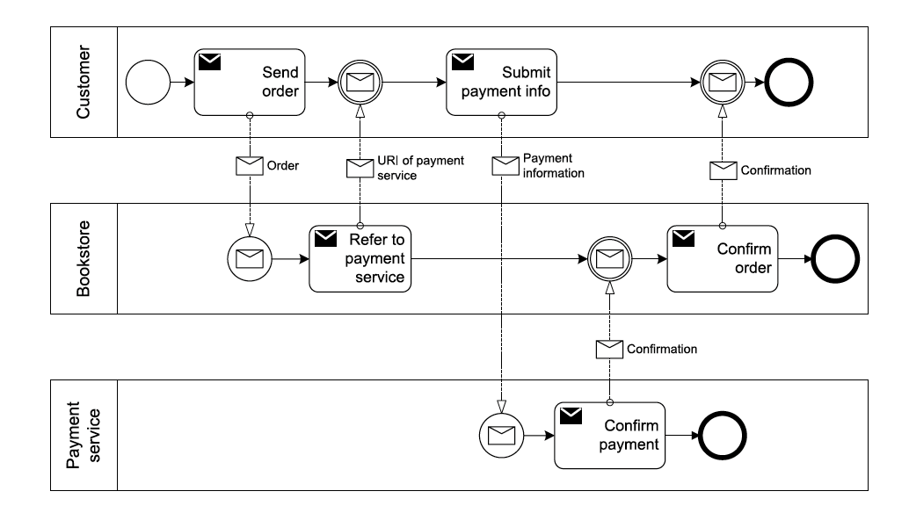
Request with referral [1]
Notes:
As an example of this pattern, consider a customer who buys a set of books online. The bookstore redirects the customer’s Web browser to the Web page of an external payment service. Conceptually, this means that the bookstore refers the payment service to the customer, who can then use the service, although the customer was not aware about this service beforehand.

Slide 36
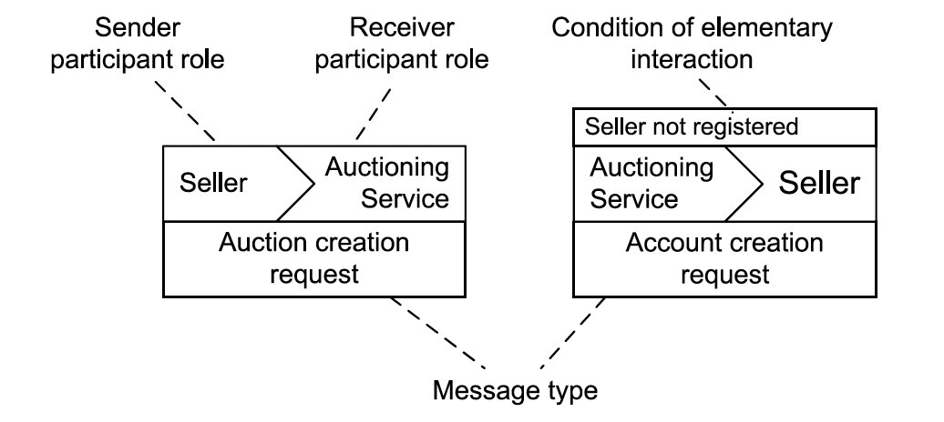
Let’s Dance [1]
Choreography language following interaction-centric approach.
Based on control flow patterns and service interaction patterns.
Control flow specification is the main focus, so the language abstracts from concrete message formats.
Notes:
In Section 5.4, Petri nets were used to express process choreographies. The main idea was to show the behavioural interfaces for the participants of a process choreography and their interconnection using message flow.
As an alternative to modelling behavioural interfaces, languages for expressing interaction models directly have been designed.
The main difference to modelling connected behavioural interfaces is that interactions are used as basic building blocks for choreographies, and behavioural dependencies are defined between these interactions.
The main focus is to capture interactions and their behavioural dependencies. Elementary interactions are the building blocks by which complex interaction rules can be defined.

Slide 37
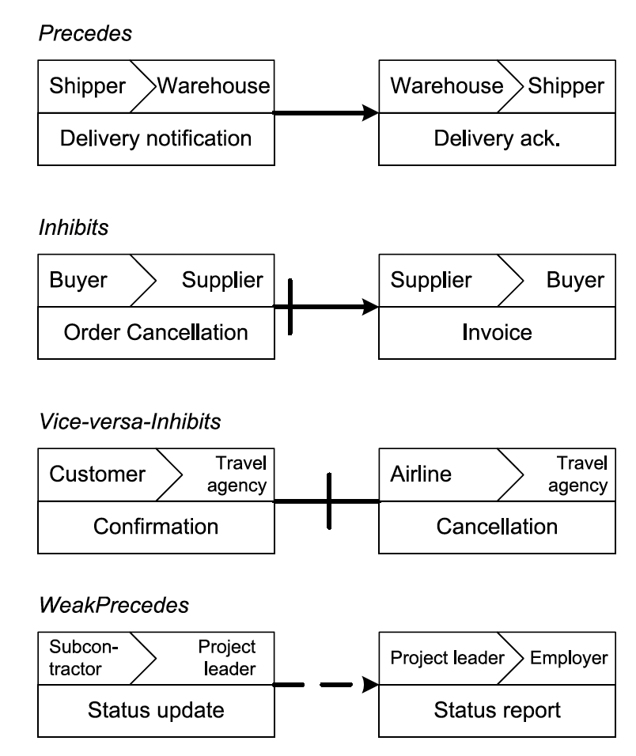
Basic control flow structures relating interactions [1]
Precedes: An instance of the target interaction can occur only if the instance of the source interaction has already occurred.
Inhibits: An instance of the target interaction can occur only if no instance of the source interaction has occurred yet.
Vice-versa-Inhibits: An instance where either one or the other interaction can complete.
WeakPrecedes: An instance of the target interaction can occur only after the instance of the source interaction has already completed or was skipped.
Notes:
If in a logistics environment a delivery acknowledgment message should be sent only after a delivery notification has been received, a precedes relationship between the respective elementary interactions can be used to represent this business rule.
In an example involving an order process, an invoice should not be sent after an order cancellation by the buyer has been received.
Consider, for instance, a travel agency that either receives a confirmation message from the customer or a cancellation message from the airline.
Imagine a project management scenario where the project leader expects status updates from a subcontractor that are merged into a status report for the employer. However, in special cases the project leader and the subcontractors can agree that no status update is needed.

Slide 38
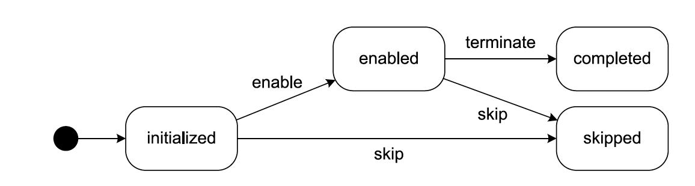
Lifecycle of interaction instances [1]
Notes:
The lifecycle of interaction instances is shown in this figure. An interaction instances can be in the states initialized, enabled, completed, and skipped.
An interaction instance becomes enabled if there are no precedes or weak precedes relationships targeting the corresponding interaction or all preceding instances are completed and all weakly preceding instances have been completed or were skipped.
An interaction instance becomes skipped if any of the inhibiting instances has completed.
An instance must execute, that is, the actual message exchange occurs, only if it is enabled. After the message exchange, the instance is in the completed state.

Slide 39
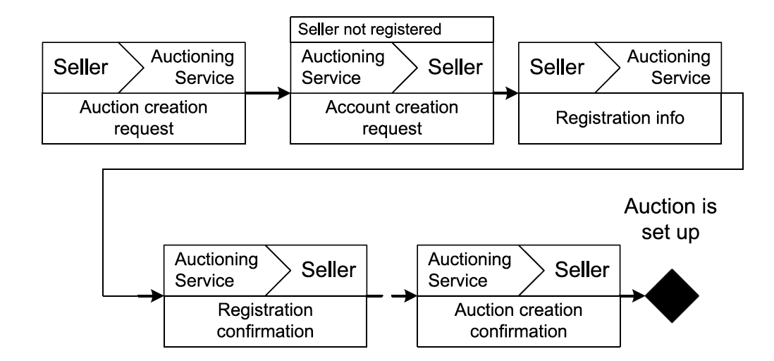
Interaction modelling [1]
Notes:
The weak precedes relationship connecting the last elementary interactions defines that the Auctioning service can send an Auction creation confirmation to the Seller if it has either sent a Registration confirmation message before or if the sending of that message was skipped. The latter is used to cater to situations in which a Seller is already registered at the Auctioning service.

Slide 40
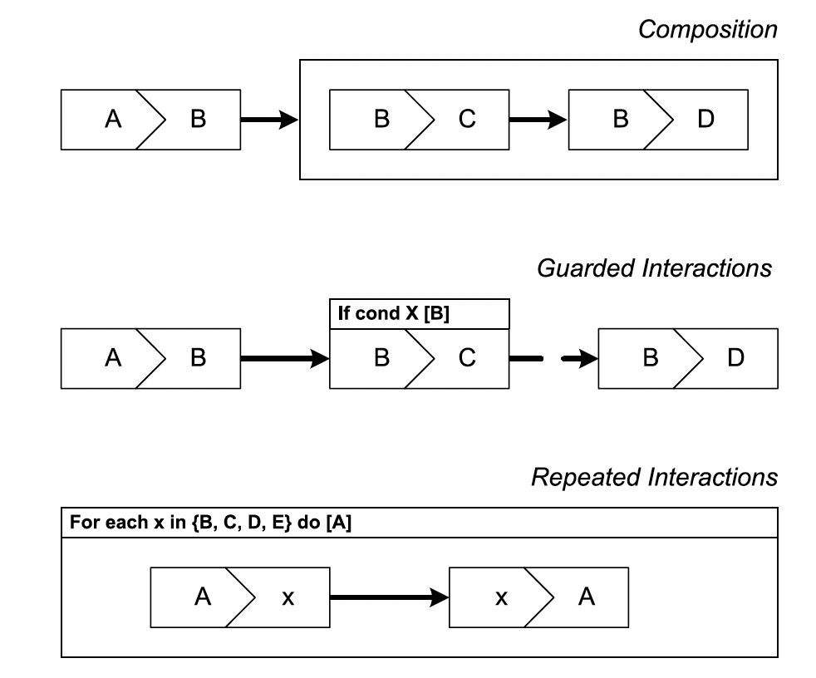
Advanced control flow constructs [1]
Notes:
None of the contained interaction instances can become enabled before the enclosing composite interaction instance has become enabled, and the composite interaction instance can only complete after all contained interaction instances have completed or been skipped.
Interactions can also be guarded, meaning that at the moment an interaction instance could become enabled, a guard condition must be fulfilled. If this condition is not fulfilled, the instance is skipped.
Finally, repetitions and parallel branching with an unbounded number of branches are modelled through repeated interactions. There are four types of repeated interactions, similar to those in programming languages:
While
Repeat
For each (sequential)
For each (concurrent)
“For each” repetitions have an expression attached that determines a collection over which the repetition is performed. The knowledge about how many instances are to be created for this interaction might be available at design time or might be known only at run time. Repetitions can have stop conditions attached to them. For instance, a repeated receive interaction should be stopped as soon as answers from ten participants have arrived.

Slide 41
References
[1] Weske, Mathias. ‘Process Choreographies’. Business Process Management: Concepts, Languages, Architectures. Berlin, Heidelberg: Springer Berlin Heidelberg, 2012. 243–291. Web.
**All the images that are used in the slides are taken from the above reference (Chapter 5).

Slide 42
Thank you!
Any questions?

